Slide 1


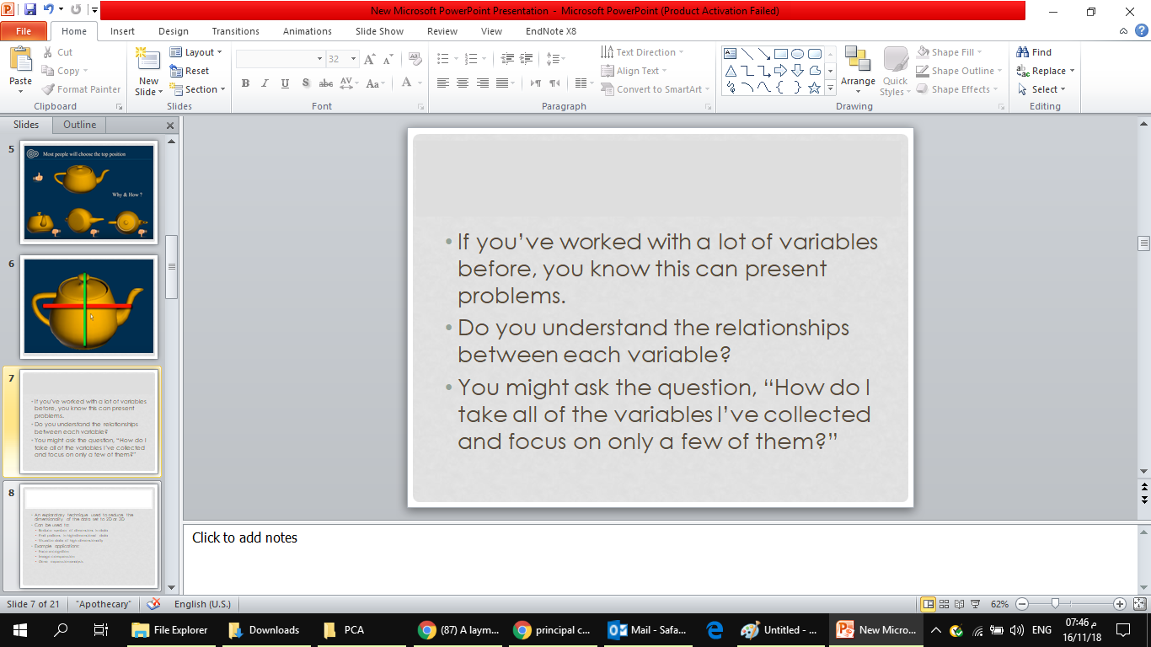

CPIS 696
Data Science
submitted to:
Dr.Gadah Alamoudi

Slide 2
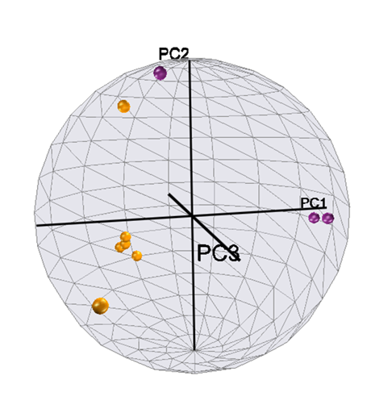
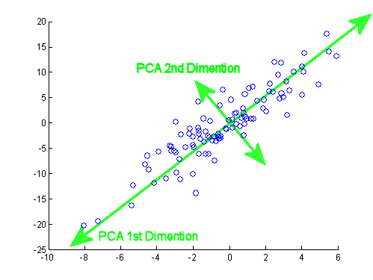
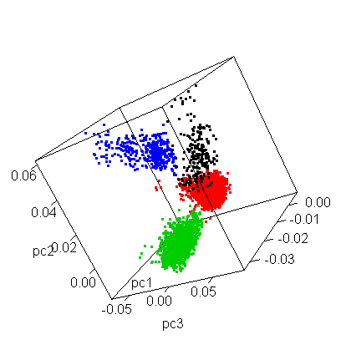
Principal Component Analysis (PCA)
presented by
Safaa Alaktheri Samah Abass
Notes:
Principal Component Analysis is type of unsupervised learning, which can highlight interesting aspects of the data without reference to any known labels.
rather than attempting to predict the y values from the x values, the unsupervised learning problem attempts to learn about the relationship between the x and y values.

Slide 3
Outline
Definition of PCA
Uses of PCA
Feature Elimination and Feature Extraction
When you Should use PCA
Explain How PCA works
weakness of PCA
Example of implementation PCA with Python

Slide 4
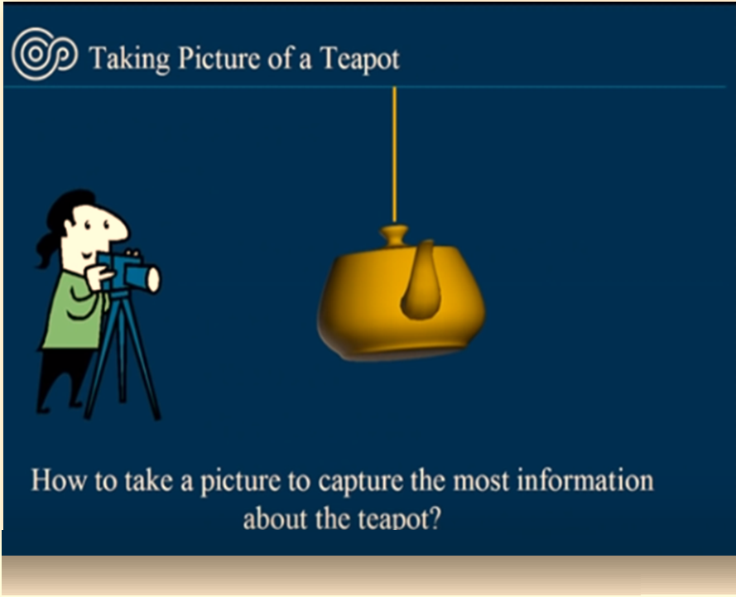
Notes:
Teapot تي بوت

Slide 5
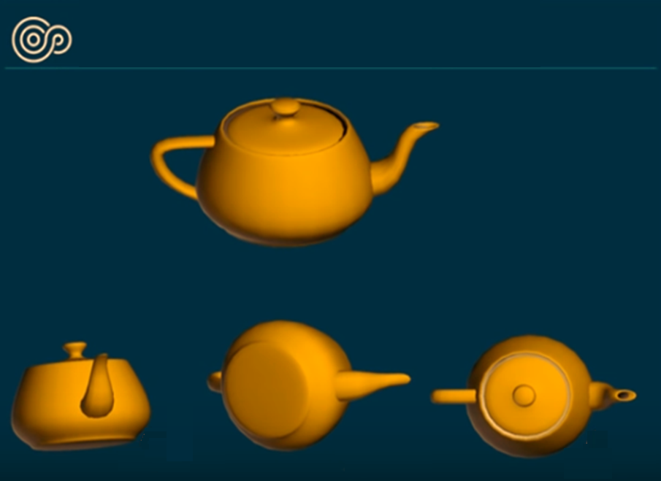

Slide 6
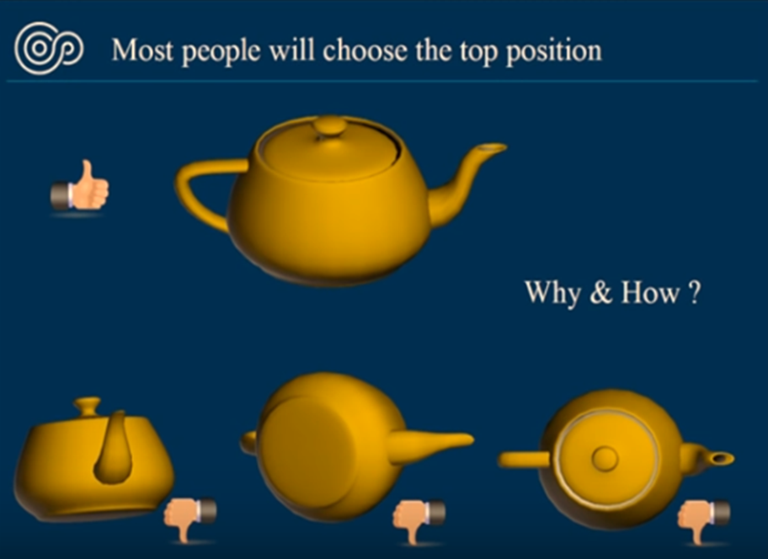

Slide 7
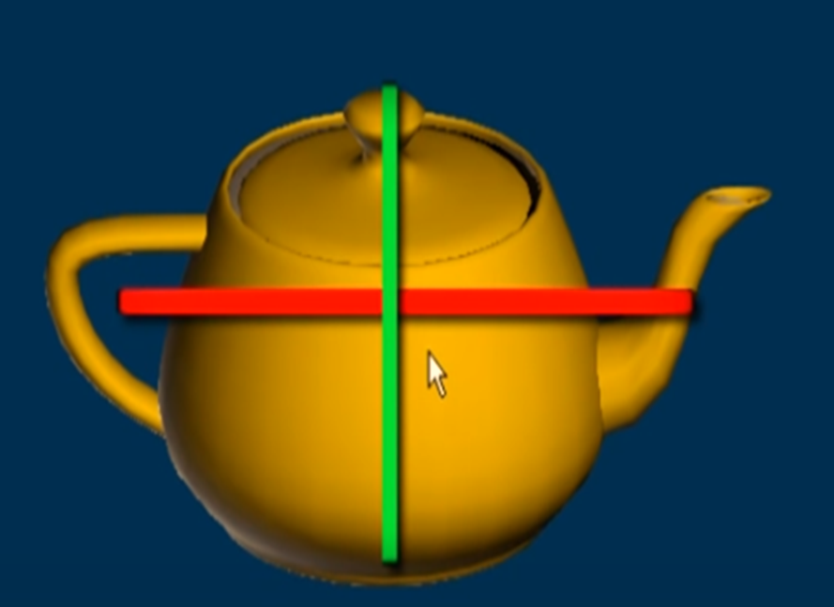

Slide 8
If you’ve worked with a lot of variables before, you know this can present problems.
Do you understand the relationships between each variable?
You might ask the question, “How do I take all of the variables I’ve collected and focus on only a few of them?”
Notes:
So the PCA solves this problem

Slide 9
Principal Component Analysis Definition
An exploratory technique used to reduce the dimensionality of the data set to 2D or 3D
Transform some large number of variables into a smaller number of uncorrelated variables called principal components (PCs).
developed to capture as much of the variation in data as possible
Notes:
veritaton

Slide 10
Feature Elimination
Feature elimination is the process of reducing the feature space by eliminating features.
Advantages include simplicity and maintaining interpretability of your variables.
As a disadvantage you gain no information from those variables you’ve dropped.

Slide 11
Feature Extraction
Feature extraction is the process of creating ten “new” independent variables from ten independent variables, where each “new” independent variable is a combination of each of the ten “old” independent variables.
Notes:
However, we create these new independent variables in a specific way and order these new variables by how well they predict our dependent variable

Slide 12
Uses of Principal Component Analysis
Can be used to:
Reduce number of dimensions in data(Feature Elimination)
Find patterns in high-dimensional data(Feature Extraction)
Visualize data of high dimensionality (Noise filtering)
Example applications:
Face recognition
Image compression
Gene expression analysis

Slide 13
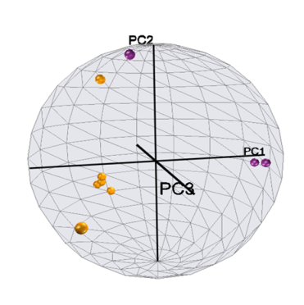
When Should I Use PCA?
Do you want to reduce the number of variables, but aren’t able to identify variables to completely remove from consideration?
Do you want to ensure your variables are independent of one another?
Are you comfortable making your independent variables less interpretable?
Notes:
If you answered “yes” to all three questions, then PCA is a good method to use. If you answered “no” to question 3, you should not use PCA.

Slide 14
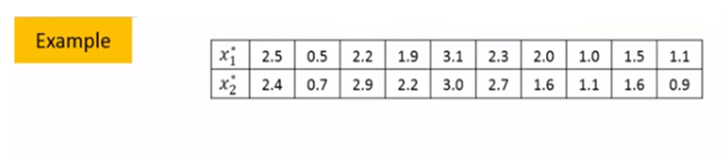
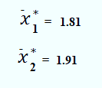
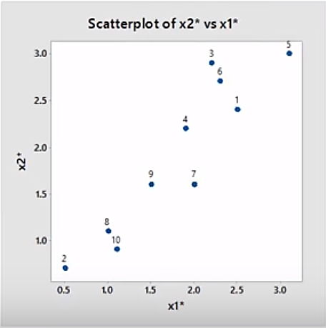
How does PCA work?
N=10
P=2
Correlation=0.93 (Strong positive correlation)(high redundancy)
Notes:
cov(X,Y)=0: independent
Cov(X,Y)>0: move same dir
Cov(X,Y)<0: move oppo dir

Slide 15
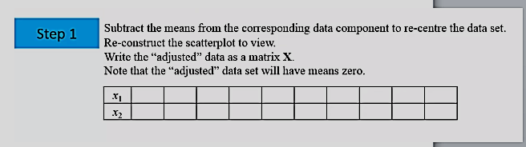
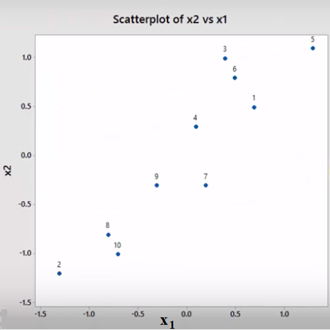
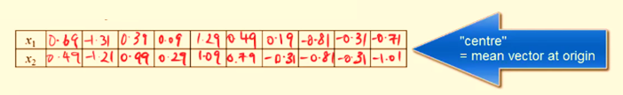
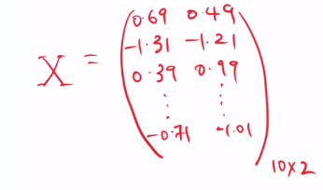

Slide 16
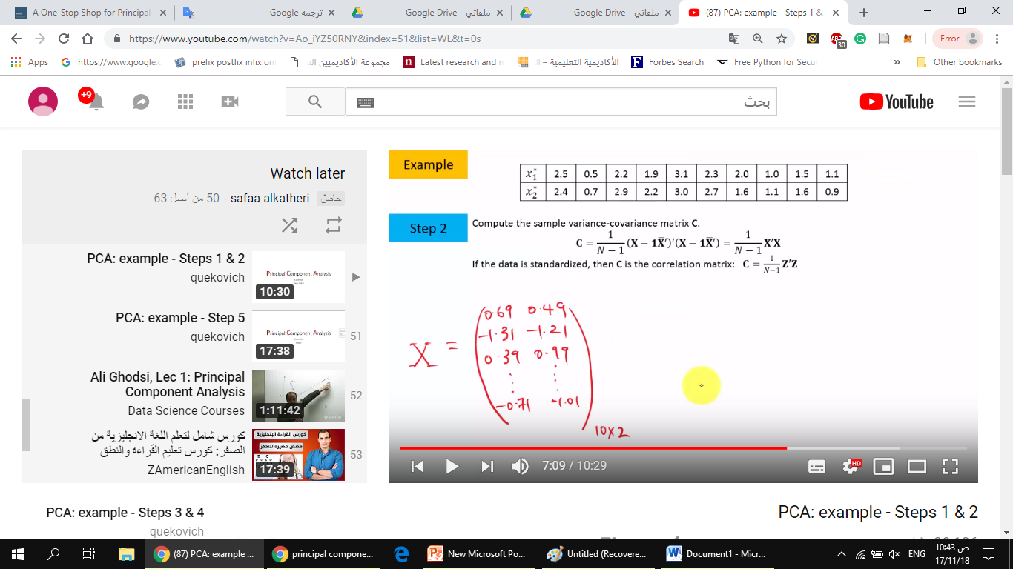
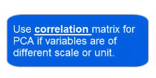
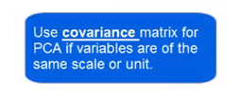
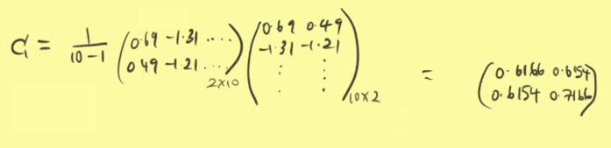
Notes:
every covariance matrix is symmetric

Slide 17
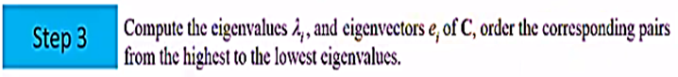
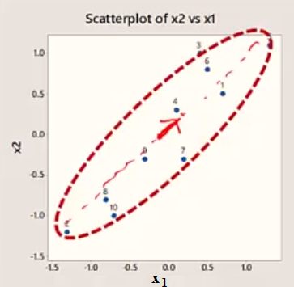
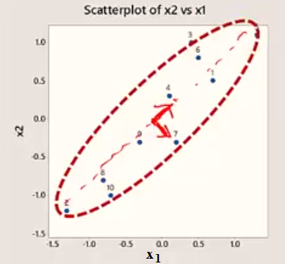
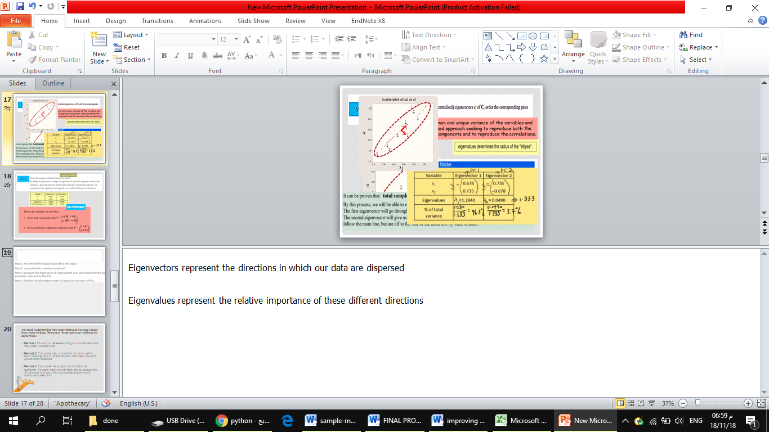
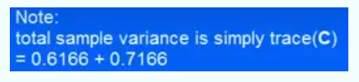
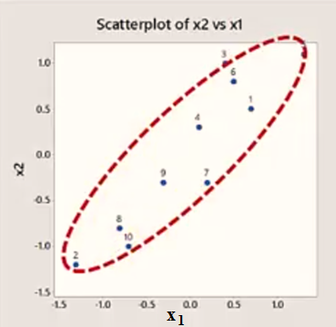
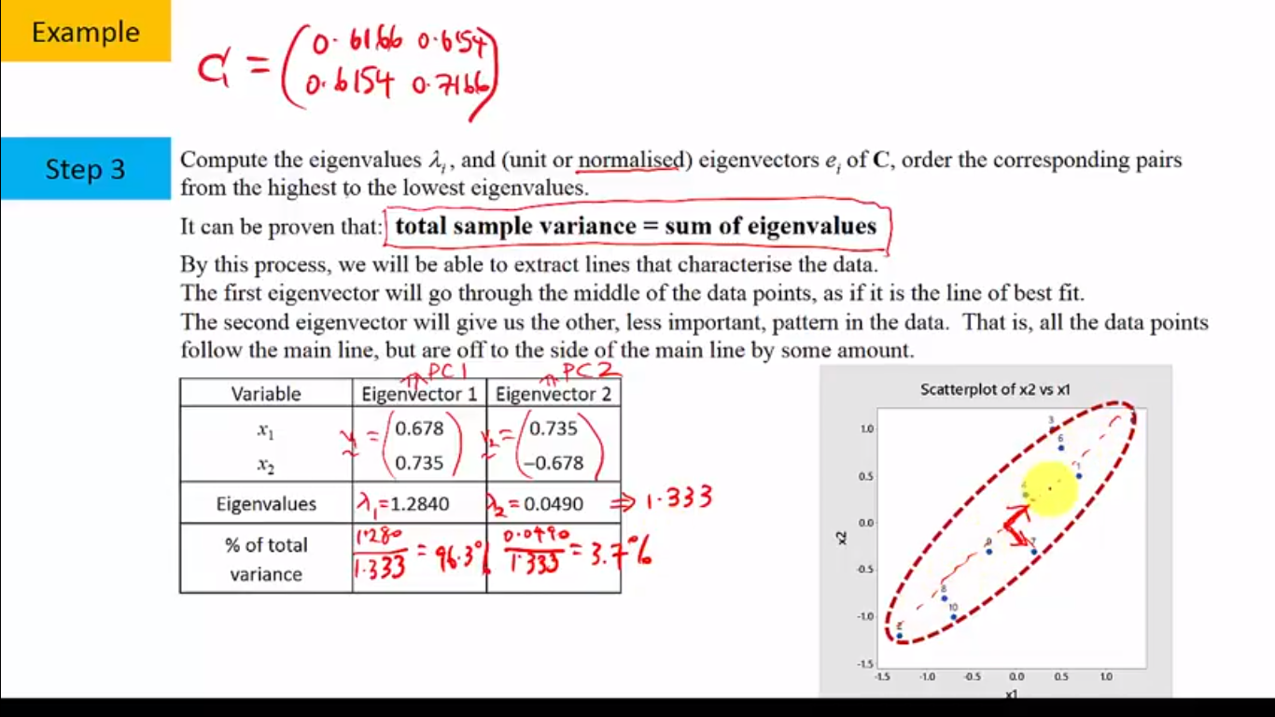
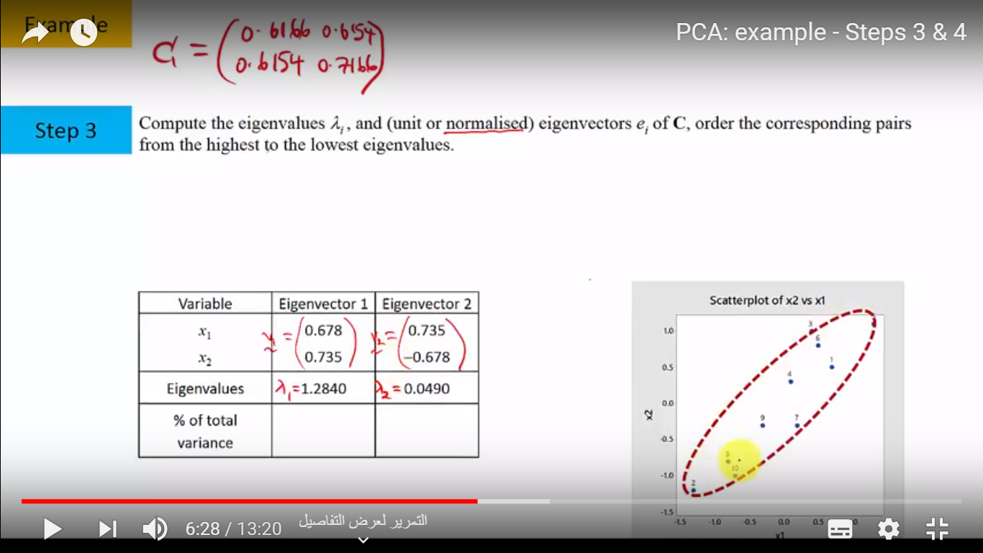
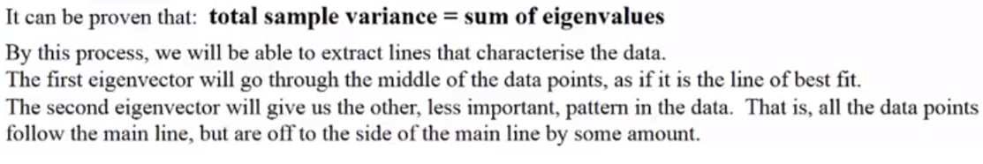
Notes:
Eigenvectors represent the directions in which our data are dispersed
Eigenvalues represent the relative importance of these different directions

Slide 18
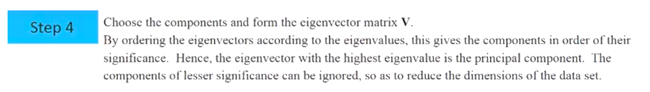
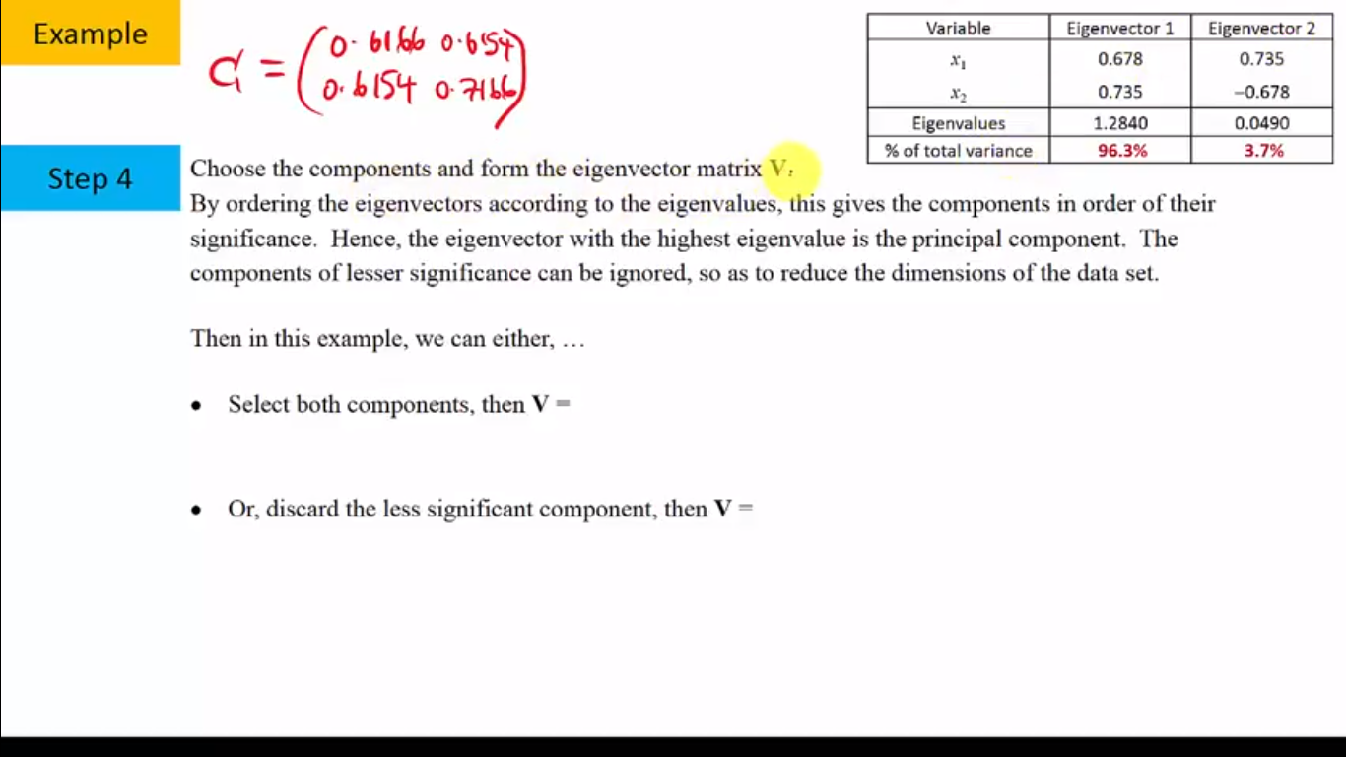

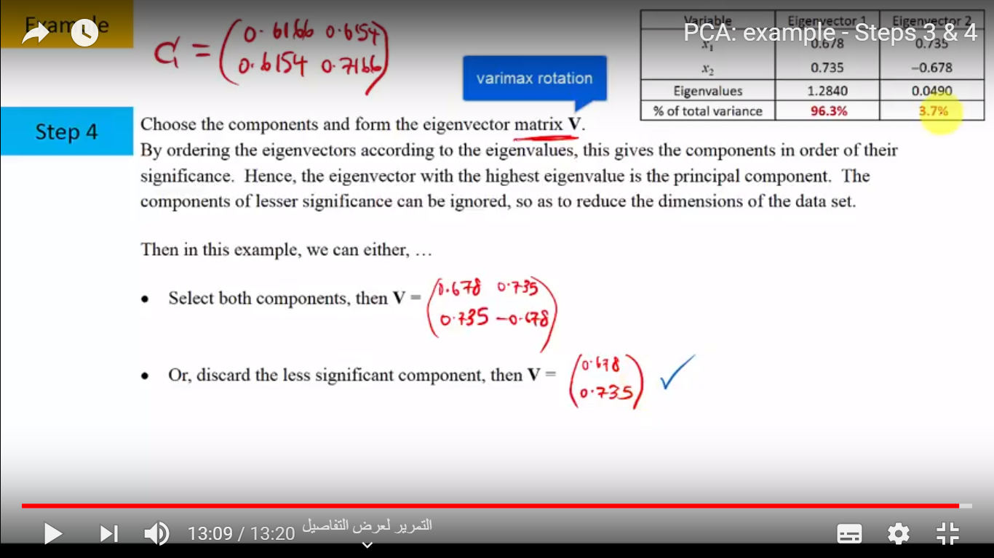

Slide 19
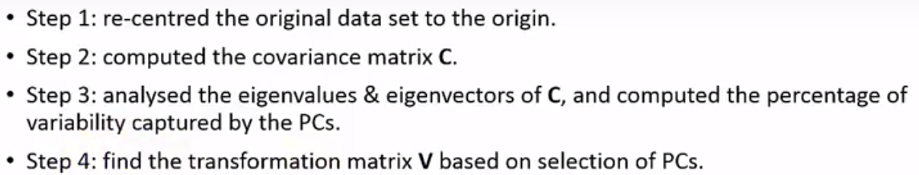

Slide 20

we need to determine how many features to keep versus how many to drop. There are three common methods to determine :
Method 1 if I want to represent things in two dimensions,I only keep two features.
Method 2: Calculate the proportion of variance for each feature, pick a threshold, and add features until you hit that threshold.
Method 3: Calculate the proportion of variance explained for each feature, sort features by proportion of variance and plot the cumulative proportion of variance( scree plot).
Notes:
(For example, if you want to explain 80% of the total variability possibly explained by your model, add features with the largest explained proportion of variance until your proportion of variance explained hits or exceeds 80%.)
One can pick how many features to include by identifying the point where adding a new feature has a significant drop in variance explained relative to the previous feature, and choosing features up until that point. (I call this the “find the elbow” method, as looking at the “bend” or “elbow” in the scree plot determines where the biggest drop in proportion of variance explained occurs.)

Slide 21
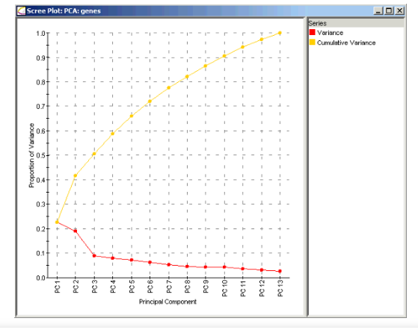
Notes:
Because each eigenvalue is roughly the importance of its corresponding eigenvector, the proportion of variance explained is the sum of the eigenvalues of the features you kept divided by the sum of the eigenvalues of all features.
onsider this scree plot for genetic data. (Source: here.) The red line indicates the proportion of variance explained by each feature, which is calculated by taking that principal component’s eigenvalue divided by the sum of all eigenvalues. The proportion of variance explained by including only principal component 1 is λ₁/(λ₁ + λ₂ + … + λp), which is about 23%. The proportion of variance explained by including only principal component 2 is λ₂/(λ₁ + λ₂ + … + λp), or about 19%.
The proportion of variance explained by including both principal components 1 and 2 is (λ₁ + λ₂)/(λ₁ + λ₂ + … + λp), which is about 42%. This is where the yellow line comes in; the yellow line indicates the cumulative proportion of variance explained if you included all principal components up to that point. For example, the yellow dot above PC2 indicates that including principal components 1 and 2 will explain about 42% of the total variance in the model.
Method 3: Here, we want to “find the elbow.” In the scree plot above, we see there’s a big drop in proportion of variability explained between principal component 2 and principal component 3. In this case, we’d likely include the first two features and drop the remaining features. As you can see, this method is a bit subjective as “elbow” doesn’t have a mathematically precise definition and, in this case, we’d include a model that explains only about 42% of the total variability.

Slide 22
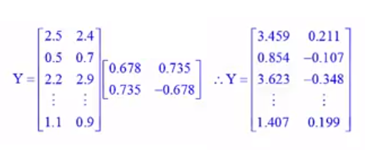
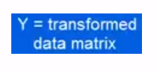
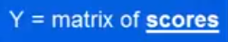
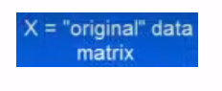
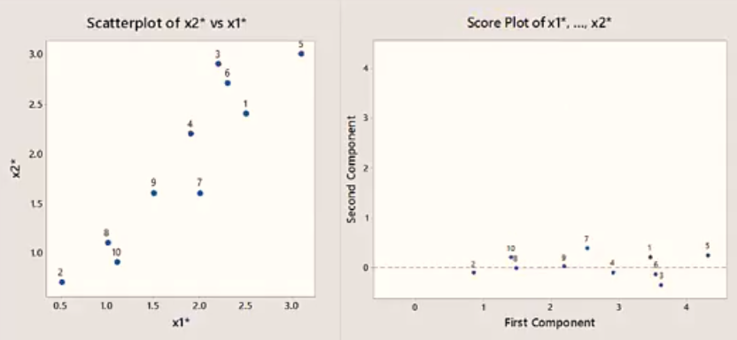
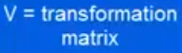

Slide 23
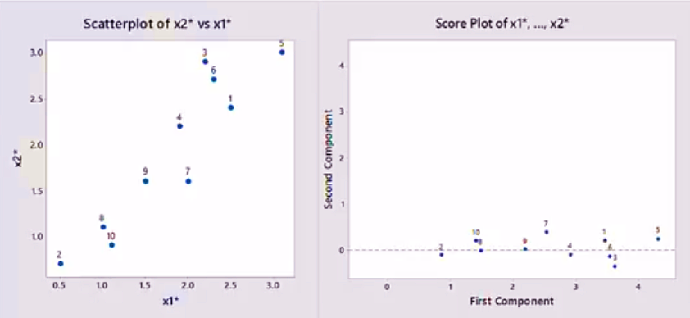
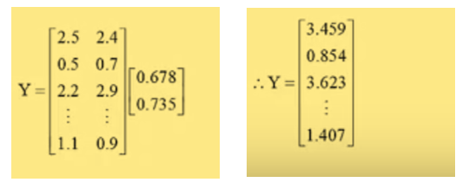
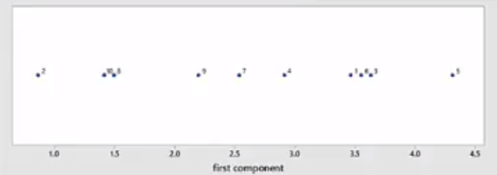

Slide 24
Notes
each of the “new” variables after PCA are all independent of one another. This is a benefit because the assumptions of a linear model require our independent variables to be independent of one another. If we decide to fit a linear regression model with these “new”, this assumption will necessarily be satisfied.

Slide 25
Weakness Of PCA
it tends to be highly affected by outliers in the data. For this reason, many variants of PCA have been developed, many of which act to iteratively discard data points that are poorly described by the initial components.
Scikit-Learn including Randomized PCA and Sparse PCA. Randomized PCA uses a non-deterministic method to quickly approximate the first few principal components in very high-dimensional data, while Sparse PCA introduces a regularization term that serves to enforce sparsity of the components.

Slide 26

PCA is a method that brings together:
A measure of how each variable is associated with one another (Covariance matrix).
The directions in which our data are dispersed (Eigenvectors).
The relative importance of these different directions (Eigenvalues).
Notes:
The directions in which our data are dispersed (Eigenvectors).
The relative importance of these different directions (Eigenvalues).

Slide 27

Example Of Implementation PCA With Python

Slide 28
References
https://towardsdatascience.com/a-one-stop-shop-for-principal-component-analysis-5582fb7e0a9c
“Python Data Science Handbook | Python Data Science Handbook.” [Online]. Available: https://jakevdp.github.io/PythonDataScienceHandbook/. [Accessed: 17-Nov-2018].
https://www.youtube.com/watch?v=BfTMmoDFXyE&t=33s&list=WL&index=63
https://www.youtube.com/watch?v=Ao_iYZ50RNY

